Slide 1
Assignment 1 – Q2, Q4, Q6
Object tracking, motor fault classification and autoencoders
University of Agder · MAS512 · 26 September 2026
Richard Rumpelt · Javier Comes Tello · Tobias Brand

Slide 2
Outline
Q2 – Object Tracking
Q4 – Classification
Q6 – Autoencoder

Slide 3
Q2 – Object Tracking
5 points
MAS512

Slide 4
Objective & Method
Objective: track the swinging load in test_swingingload.avi and show its trajectory as it swings
Method:
  Detector: the YOLO model trained in Q1 (best.pt)
  model.track(frame, persist=True) on every frame – keeps the same object identity across frames
  Bounding-box center (cx, cy) extracted for every frame the load is detected in
  Plot all centers as a scatter of pixel coordinates X vs. Y

Slide 5
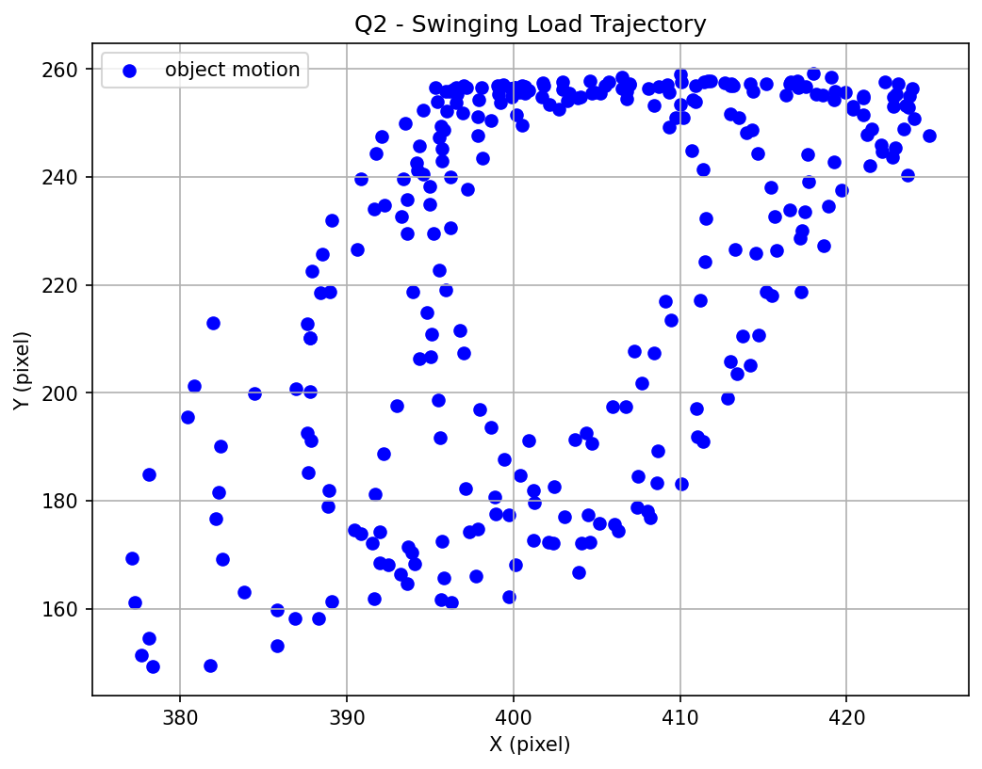
Result
Load detected and tracked in all 300 test-video frames – the pendulum-like swing arc is clearly visible

Slide 6
Q4 – Classification
10 points
MAS512

Slide 7
Objective & Data
Objective: determine motor state of health (healthy vs. faulty) and compare an own CNN against the baseline architecture given in class
Data: fault-classification-class – vibration scalograms (laser vibrometer → wavelet transform), 60×175×3 px
180 measurements per class, each split into 5 time-window crops ⇒ 900 images/class
Fixed 80/20 split by measurement number (1–144 train, 145–180 val) – no data leakage between crops of the same measurement
 | Training | Validation | Test
Images | 1440 | 360 | 200

Slide 8
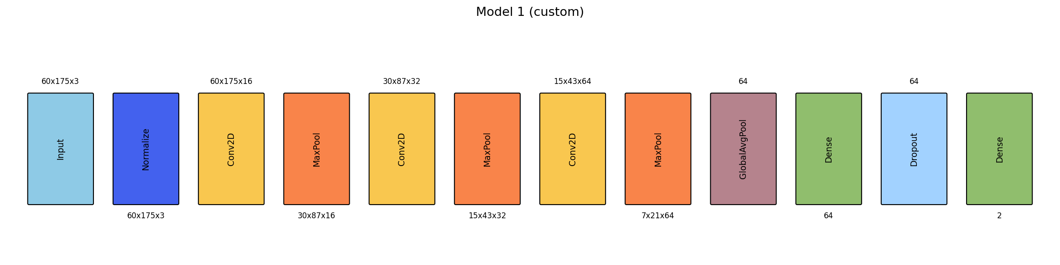
Model 1 (own) vs. Model 2 (given baseline)
Model 1 (custom, 27.9k params):
  3×[Conv2D+MaxPool] (16→32→64), GlobalAveragePooling, Dense(64)
Model 2 (given, 105k params):
  5×[Conv2D+MaxPool+ReLU] (8→16→64→64→64), Flatten(320), FC(64)

Slide 9
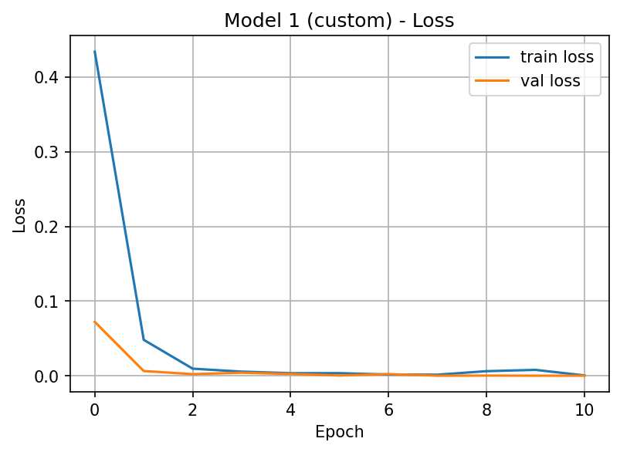
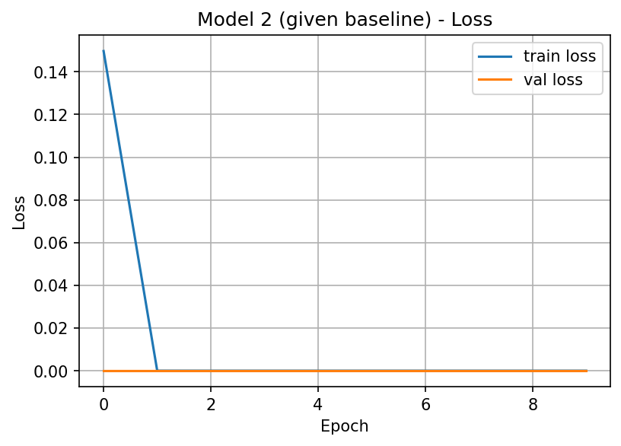
Training
Adam, categorical cross-entropy, EarlyStopping on validation loss (patience 3, best weights restored)

Slide 10
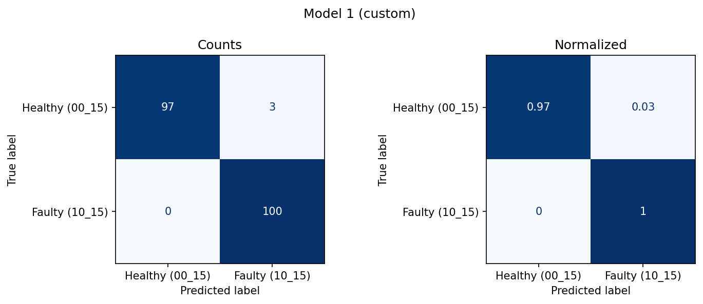

Evaluation

Slide 11
Comparison & Conclusion
Model | Params | Inference | Accuracy | Precision | F1
Model 1 (custom) | 27,874 | 0.76 ms | 0.985 | 0.985 | 0.985
Model 2 (baseline) | 105,202 | 0.76 ms | 0.985 | 0.985 | 0.985
Both models are close to perfect – the two classes are visually very distinct in the scalograms
Model 1 reaches the same accuracy with 3.8× fewer parameters, mainly from GlobalAveragePooling instead of Flatten

Slide 12
Q6 – Autoencoder
10 points
MAS512

Slide 13
Objective & Method
Objective: compress each scalogram to a latent vector and reconstruct it, for 10 random images per class
Method: dense autoencoder (matches the architecture shown in class)
60×175×3 (31,500) → Dense 256 → 32 (latent z) → Dense 256 → 60×175×3 (31,500)
Trained unsupervised: target = input itself, loss = MSE (reconstruction error)

Slide 14
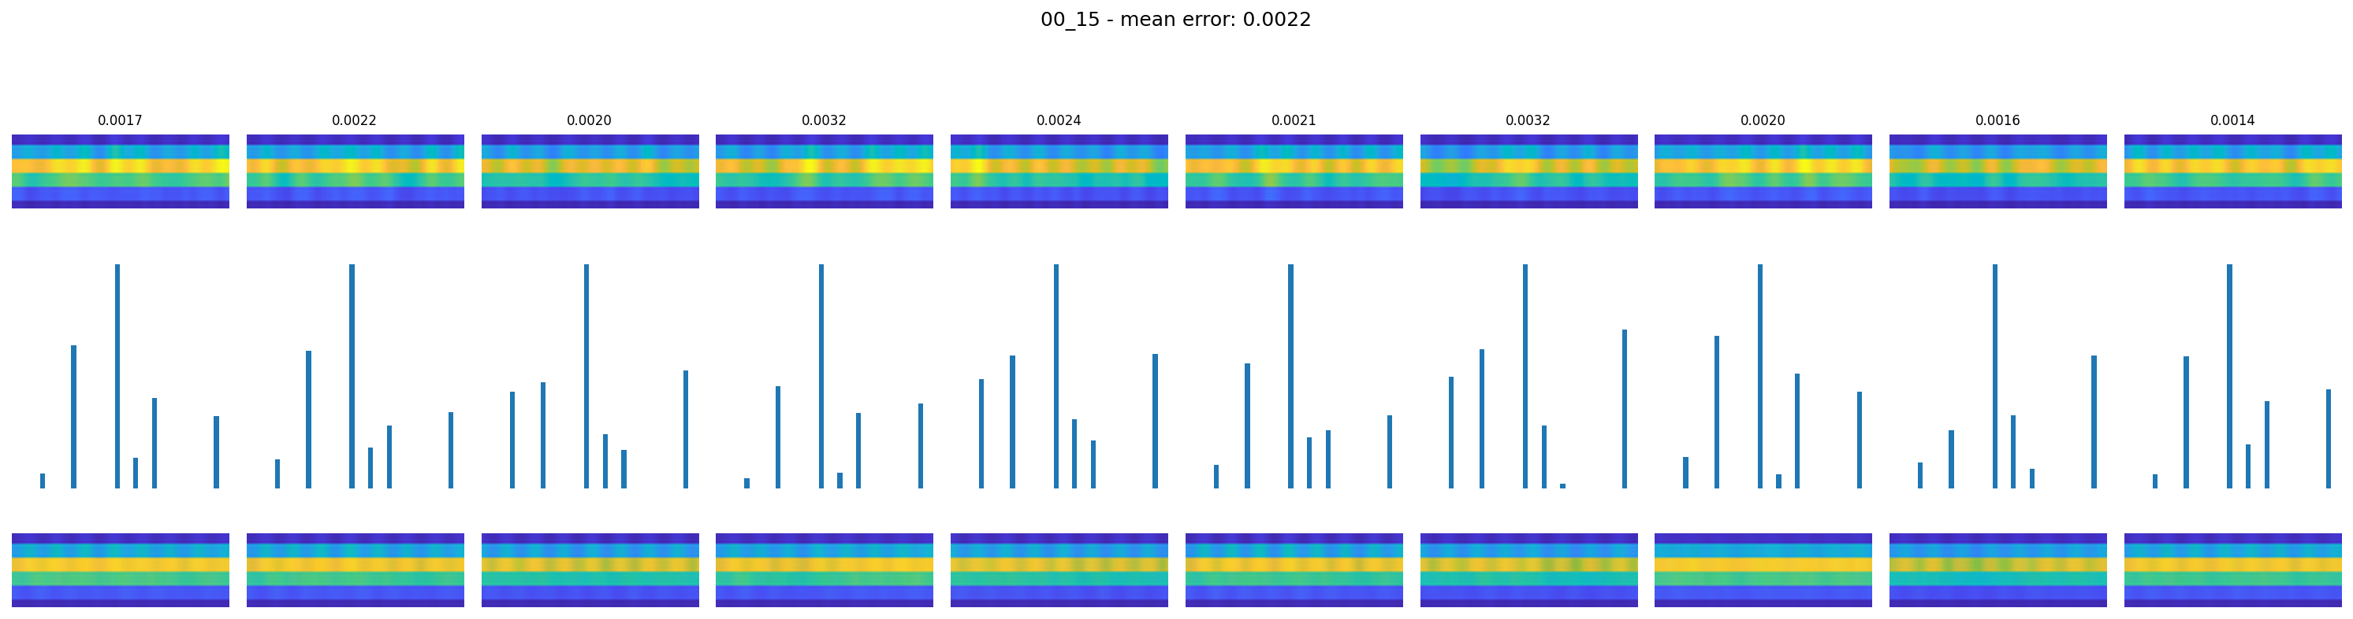
Result – Healthy (00_15)

Slide 15
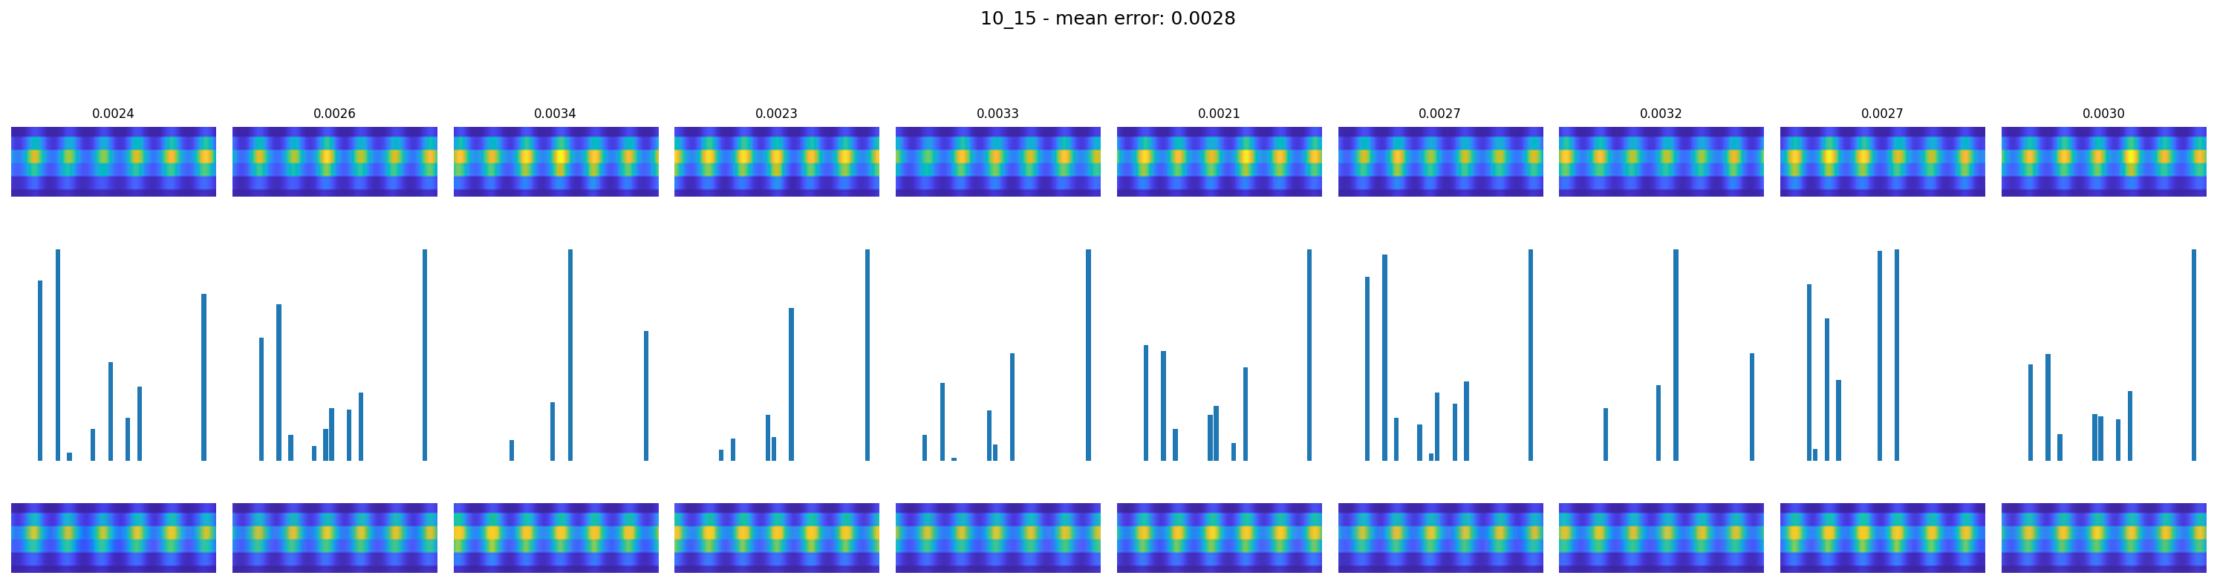
Result – Faulty (10_15)

Slide 16
Conclusion
Class | Mean reconstruction error (MSE)
Healthy (00_15) | 0.0022
Faulty (10_15) | 0.0028
Both classes reconstruct well – the 32-value latent vector preserves the overall band pattern
Faulty images have a slightly higher error: the periodic peak pattern carries more high-frequency detail than the smooth healthy band, making it harder to compress into 32 numbers

